Slide 1
正文科技公司介紹
Nov, 2019
Gemtek Confidential
Distribution Prohibited

Slide 2
Safe Harbor Notice
The following presentation may contain forward-looking statements regarding, among other things, our financial condition, future expansion plans and business strategies based on our current expectations and projections about future events. Although we believe that these expectations and projections are reasonable, such forward-looking statements are inherently subject to risks, uncertainties and assumptions.
The company undertakes no obligation to publicly update or revise any forward-looking statements whether as a result of new information, future events or otherwise. The actual results could differ materially from those contained in these forward-looking statements.

Slide 3
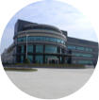
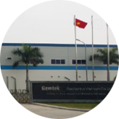
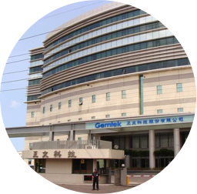
關於正文
建立: 1988
總部: Hsinchu Industrial Park, Hsinchu, Taiwan(Headquater)
全球員工人數:≈ 4,000 (TWN: 1,000 )
資本額: NT$35.1 億元 (US$104.13 百萬元)
Chang Shu Plant
Plant Size: 441,600.SQF
Land Size: 1,635,520.SQF
Vietnam Plant
Czech Republic
Plant Size: 280,000 SQF Land Area: 387,500 SQF
Plant Size: 102,000 SQF
Certified Sites:
ISO 9001
ISO 14001
ISO 13485
OHSAS 18001
TL9000
C-TPAT
KuShan Plant
Plant Size: 330,000 SQF
Land Area: 150,000 SQF
Hsinchu Headquarter
Floor Space: 322,000 SQF
Land Area: 215,000 SQF

Slide 4
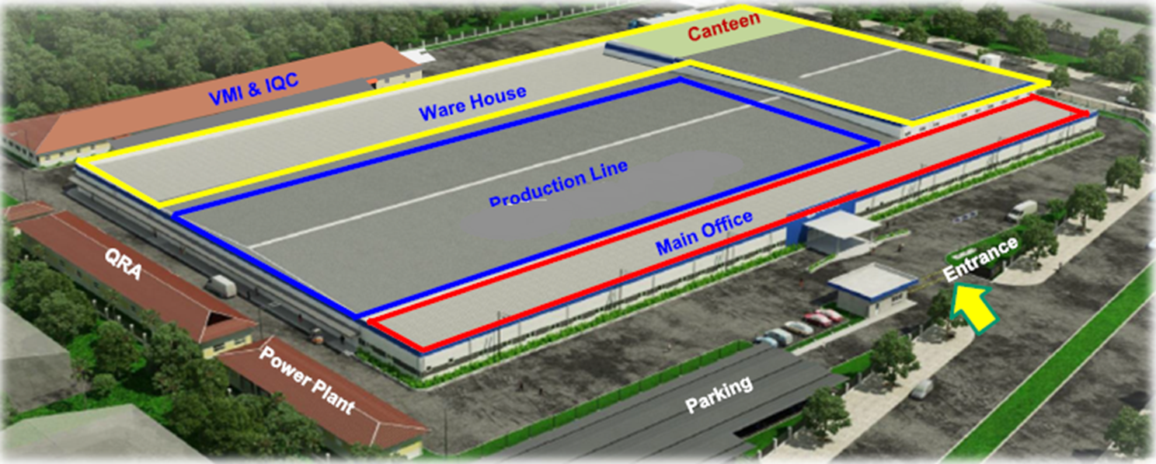
正文越南廠
Opening date: 2019/02/20
Location : Dong Van II Industrial Park, Bach Thuong Commune, Duy Tien District, Ha Nam Province, Vietnam
Land : 36,000 m²
Building : 26,000 m²

Slide 5
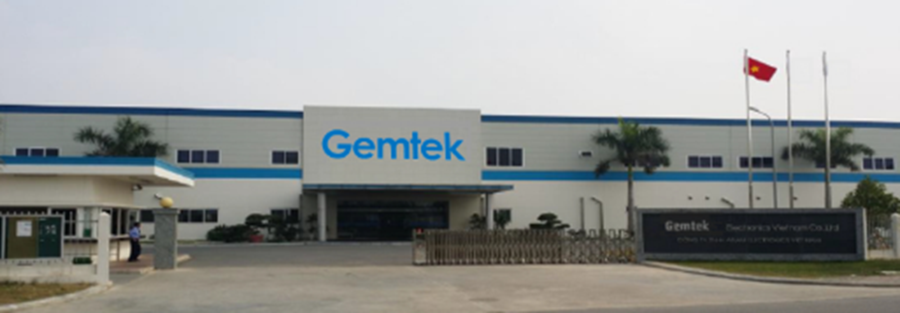
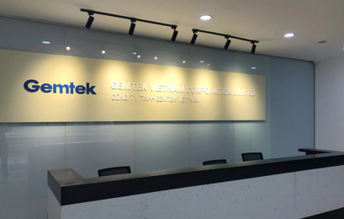
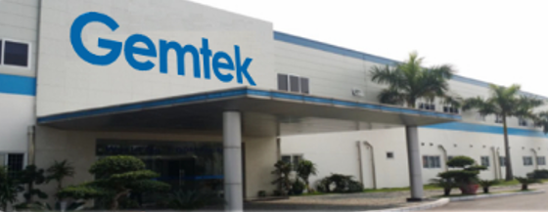
正文越南廠
Front Door View
Inside View
Front View

Slide 6
2019 Q3 財務報表

Slide 7
2019 截至 Q3 損益表
Units: NT$ Thousands; Consolidated
 | Sep 30 2019 |  | Sep 30 2018
 | Amount % |  | Amount %
Sales Revenue (k)- | 14,429,289 | 100% | 12,225,996 | 100%
Gross Profit(K) | 1,359,382 | 9% | 1,097,784 | 9%
Operating Income | 73,631 | 0.51% | (133,601) | (1%)
Non-Operating income and expense | 302,098 | 2% | 148,114 | 1%
Net Profit After Tax (k) | 286,903 | 2% | (35,890) | (0.3%)
EPS after tax | 0.8 |  | (0.11)

Slide 8
2019 Q3 資產負債表
Units: NT$ Thousands; Consolidated
Asset | Sep 30 2019 Amount %
Cash and Cash Equivalents | 2,028,722 | 13%
A/R | 5,289,136 | 34%
Inventory | 2,375,249 | 15%
Other Current Assets | 184,768 | 1%
Non-current Asset | 5,146,595 | 33%
Total Assets | 15,493,769 100%
Liability and Equity | Sep 30 2019 Amount %
Short-term borrowing | 558,360 | 4%
A/P | 3,881,258 | 25%
Other Current Liabilities | 55,421 | 0.4%
Non-current Liabilities | 1,388,001 | 9%
Total Liabilities | 6,770,448 | 44%
Total Equity | 8,723,321 | 56%
Total Liabilities & Equity | 15,493,769 100%
Notes:
8

Slide 9
營收成長曲線
Increase
28%
(Compare to 2017)

Slide 10
2019 每季毛利變化

Slide 11
2019 Q3 產品組合佔比

Slide 12
展望與新技術

Slide 13
策略
Wireless Access
Cooperate with Chip Vendors and provide time to market solution of WiFi service platform
Fixed Broadband
Targeting at the next generation broadband access technology, 10GPON, to fulfill Telco and Cable MSO business needs and migration, as well as supporting 5G infrastructure
Target market: Mesh AP system, gaming router, wireless streaming, Enterprise Market (Carrier Provider)
Focus on the product of Telecom infrastructure Ex: LTE CPE, small cell, 5G product
Developing continuously on copper technologies (G.fast) to provide a compliment FTTx service demands
Increase production lines utilization rate and seize opportunity to increase revenue

Slide 14
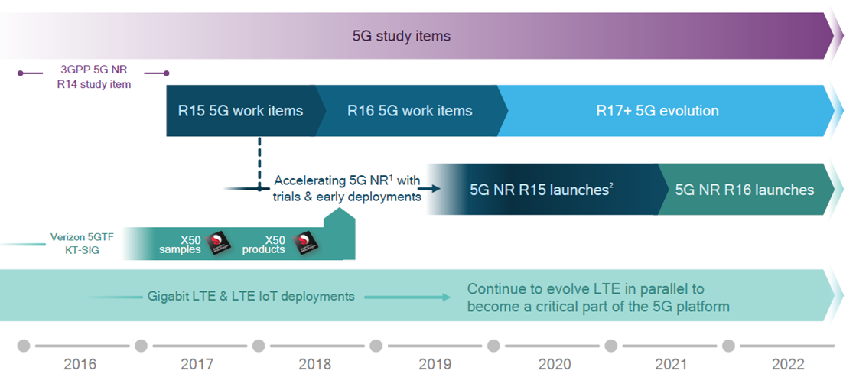
5G 進程
Source: Qualcomm

Slide 15
5G 策略
Small Cell
Sign agreement /contract with platform venders (Base Band and Remote Radio Head) to develop hardware (on going)
Working with protocol Stack venders to develop 5G product (on going)
Working with mmWave partners for outdoor small cell
(on going)
Develop customers oriented features for vertical and enterprise business. Product will be ready in 2020

Slide 16
5G 策略
UE (CPE and other fixed devices)
Working with chip set venders to develop CPE in Sub 6G (2019)
Sign agreement with Fibocom ( Intel module provider) using Intel Sub 6G chipset XMM 8160 for CPE development.
Developed with Intel and release in 2019 MWC
Add mmWave features on CPE ,Outdoor devices (2020)
Provide dual mode (LTE and 5G NR) CPE to current LTE customers (2020)

Slide 17
Wi-Fi 設備市場
全球Wi-Fi連網裝置出貨量預測 2017-2023年

Slide 18
Wi-Fi 設備市場

Slide 19
未來展望
Revenue and Margin Challenge
Impact of The US – China Trade War.
The uncertainty of external economic environment
2019 outlook
Cooperating with worldwide System Integrators, increasing telco market share.
Launching 5G related products.
5G main focus: Small cell , CPE and other fixed devices.
Launching WiFi-6 related products.
Focus on high value-added market.
Seize opportunity to increase revenue and reduce the cost

Slide 20
THANK YOU

Slide 21
Q & A

